Slide 1
Dissertation Defense
Preservice Mathematics Teachers’ Perceptions of Using a Web 2.0 Technology as a Supportive Teaching-Learning Tool in a College Euclidean Geometry Course
A dissertation submitted in partial fulfillment of the requirements for the degree of Doctor of Philosophy in
Curriculum, Teaching, and Learning
with an emphasis on
Information Technology in Teaching-Learning Mathematics
by
Md. Mokter Hossain
University of Nevada, Reno
April 27, 2012

Slide 2
Preservice Mathematics Teachers’ Perceptions of Using a Web 2.0 Technology as a Supportive Teaching-Learning Tool in a College Euclidean Geometry Course
OVERVIEW
The Organization of this Presentation
INTRODUCTION
SUMMARY OF LITERATURE REVIEW
METHODOLOGY
DATA ANALYSIS, RESULTS, AND DISCUSSION
IMPLICATIONS, RECOMMENDATIONS, AND CONCLUSIONS
QUESTIONS & ANSWERS

Slide 3
Preservice Mathematics Teachers’ Perceptions of Using a Web 2.0 Technology as a Supportive Teaching-Learning Tool in a College Euclidean Geometry Course
FOR THE GUESTS
What is a Web 2.0 Technology?
A collaborative Web Development Platform.
Allows users to develop user-centered, participatory Web applications.
Example: Blogs, Wikis, LinkedIn, MySpace, Facebook, YouTube are successful applications of Web 2.0 technology.
Interactive Features of Web 2.0 Technologies
Users can add, control, and share information interactively and simultaneously on the Web, mostly for free.
Creating and editing most Web 2.0 applications is free, fast, and requires only basic computing knowledge.

Slide 4
Preservice Mathematics Teachers’ Perceptions of Using a Web 2.0 Technology as a Supportive Teaching-Learning Tool in a College Euclidean Geometry Course
INTRODUCTION
Introduction
Technology use is emphasized in the NCTM (2000) Principles and Standards for School Mathematics, in the United States
However, use of technology is not available and effective at all levels; especially in teacher education programs
Increasing demand of mathematics teaching-learning software and web-based programs
High cost/annual license fee; and high configuration computers
Young students’ trends on social networking sites
Expectation of free, anywhere, anytime and easy to use programs
Web 2.0 technology has a great potential to meet these demands

Slide 5
Preservice Mathematics Teachers’ Perceptions of Using a Web 2.0 Technology as a Supportive Teaching-Learning Tool in a College Euclidean Geometry Course
INTRODUCTION
Background of the Study
Technology is playing an increasingly important role in teaching-learning mathematics at all levels in the United States
However, U.S. students’ performance in math is not satisfactory
Young students and teachers spend considerable time on social networking sites
Statement of the Problem
Traditional mathematics programs and websites are costly and are not accessible to many students/teachers worldwide
Web 2.0 technology has a great potential to solve this problem
As a standard and easy Web 2.0 tool, use of blogs should be examined in a mathematics course as a teaching-learning tool

Slide 6
Preservice Mathematics Teachers’ Perceptions of Using a Web 2.0 Technology as a Supportive Teaching-Learning Tool in a College Euclidean Geometry Course
INTRODUCTION
Purpose of the Study
Examine preservice secondary mathematics teachers’ perceptions (in terms of their attitudes toward, and perceived effectiveness of) a blogging activity used as a supportive teaching-learning tool in a college Euclidean Geometry Course
Significance of the Study
As a standard example of Web 2.0 application, Blog was Selected as a supportive Teaching-Learning Tool
Use of a Blog might be a new dimension of using technology
Most of the Participants were Preservice Mathematics Teachers
Results may be useful for Math Students, Teachers, & Educators

Slide 7
Preservice Mathematics Teachers’ Perceptions of Using a Web 2.0 Technology as a Supportive Teaching-Learning Tool in a College Euclidean Geometry Course
INTRODUCTION
Theoretical Framework
Collaboration, constructivism, and motivational features of Web 2.0
Rationale of Selecting the Independent Variables
Males and females use Internet very differently
There is a strong positive correlation between time spent on the Internet and time spent on social network sites
More time spent on Internet practice may increase adult learners’ Internet self-efficacy
Rationale of correlating perceptions with quiz scores
Students who are strong in math might have different perceptions of using a new teaching-learning tool

Slide 8
Preservice Mathematics Teachers’ Perceptions of Using a Web 2.0 Technology as a Supportive Teaching-Learning Tool in a College Euclidean Geometry Course
INTRODUCTION
Research Questions
Quantitative Research Questions
Research question 1a. Are there significant differences by gender with regard to preservice mathematics teachers’ attitudes toward the blogging activity in a college Euclidean Geometry Course?
Research question 1b. Are there significant differences by gender with regard to preservice mathematics teachers’ perceived effectiveness of the blog for the learning of Euclidean Geometry?

Slide 9
Preservice Mathematics Teachers’ Perceptions of Using a Web 2.0 Technology as a Supportive Teaching-Learning Tool in a College Euclidean Geometry Course
INTRODUCTION
Research Questions
Quantitative Research Questions…
Research question 2a. Do preservice teachers who report spending more time on the Internet differ significantly from those who report spending less time on the Internet with regard to their attitudes toward the blogging activity in a college Euclidean Geometry Course?
Research question 2b. Do preservice teachers who report spending more time on the Internet differ significantly from those who report spending less time on the Internet with regard to their perceived effectiveness of the blog for the learning of Euclidean Geometry?

Slide 10
Preservice Mathematics Teachers’ Perceptions of Using a Web 2.0 Technology as a Supportive Teaching-Learning Tool in a College Euclidean Geometry Course
INTRODUCTION
Research Questions
Quantitative Research Questions…
Research question 3a. Is there a relationship between the cumulative quiz scores attained by preservice mathematics teachers enrolled in a college Euclidean Geometry Course and their attitudes toward the blogging activity in a college Euclidean Geometry Course?
Research question 3b. Is there a relationship between the cumulative quiz scores attained by preservice mathematics teachers enrolled in a college Euclidean Geometry Course and their perceptions of the effectiveness of the blog for the learning of Euclidean Geometry?

Slide 11
Preservice Mathematics Teachers’ Perceptions of Using a Web 2.0 Technology as a Supportive Teaching-Learning Tool in a College Euclidean Geometry Course
INTRODUCTION
Research Questions
Qualitative Research Questions…
Research question 4. What do preservice secondary mathematics teachers perceive as the advantages and disadvantages of using a blog as a supportive tool in a Euclidean Geometry course?
Research question 5. What trends emerge in the analysis of student contributions to an online discussion board on a blog used in a college Euclidean Geometry course?

Slide 12
Preservice Mathematics Teachers’ Perceptions of Using a Web 2.0 Technology as a Supportive Teaching-Learning Tool in a College Euclidean Geometry Course
REVIEW OF LITERATURE
The Review of Literature Focuses on …
Web 1.0-Based Virtual Learning Systems
Understanding Web 2.0 Technologies
What are Web 2.0 Technologies?
Some Web 2.0-Based Applications
Interactive Features of Web 2.0 Technologies
Rapid Growth of Internet and Mobile Web Usage
Young Students’ Trends on Web 2.0 Technologies
Use and Impact of Web 2.0 Technologies for Teaching-Learning Purposes
Current State of Math Education in the United States
Potential Use of Web 2.0 in Promoting Math Education

Slide 13
Preservice Mathematics Teachers’ Perceptions of Using a Web 2.0 Technology as a Supportive Teaching-Learning Tool in a College Euclidean Geometry Course
METHODOLOGY
Research Questions
Both Quantitative and Qualitative
Research Design
A Mixed-Methods Study
Instrumentation
Validity and Reliability of the Instrument
Selection of Participants
Students who agreed to participate in the Blogging Activity
Data Collection
From the Survey: Demographics, Likert-type & Open-ended
From the Discussion Page on the Blog

Slide 14
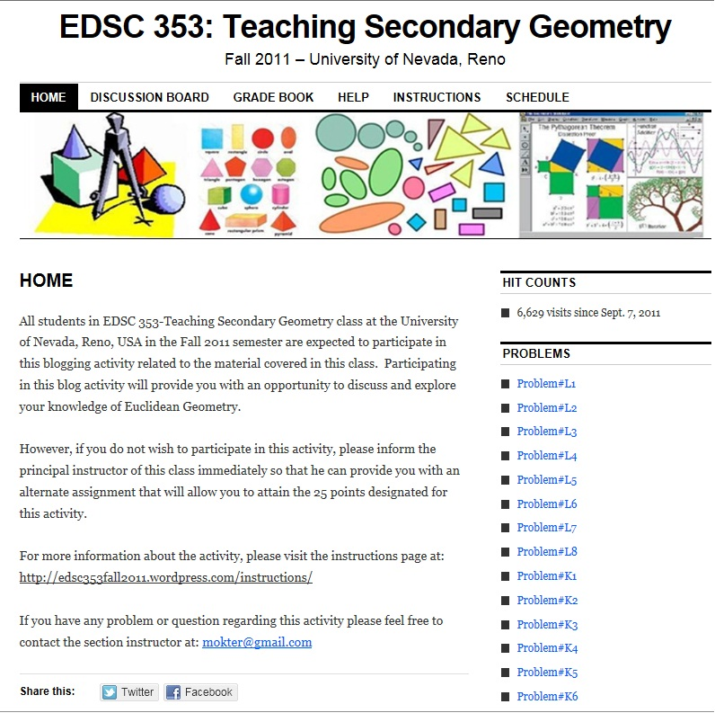
METHODOLOGY
The Blogging Activity

Slide 15
Preservice Mathematics Teachers’ Perceptions of Using a Web 2.0 Technology as a Supportive Teaching-Learning Tool in a College Euclidean Geometry Course
METHODOLOGY
Working Definitions
Independent Variables:
(1) Participants’ gender –two categories: male and female;
(2) Participants’ time spent on the Internet – divided into two categories using a median split.
Dependent Variables:
Participants’ attitudes scores – measured by calculating the median response to the 16 Likert-type items on a six-point scale;
Participants’ perceived effectiveness scores– measured by calculating the median response to another 18 Likert-type scale items on a six-point scale; and
Participants’ cumulative quiz scores attained on eight in-class quizzes.

Slide 16
Preservice Mathematics Teachers’ Perceptions of Using a Web 2.0 Technology as a Supportive Teaching-Learning Tool in a College Euclidean Geometry Course
METHODOLOGY
Analyses of Data
Quantitative Data – Using SPSS for Windows
For RQs 1a & 1b - W-M-W U test on median attitude and perceived effectiveness scores, respectively with gender as an independent variable;
For RQs 2a & 2b - W-M-W U test on median attitude and perceived effectiveness scores, respectively with time spent on the Internet as an independent variable;
For RQs 3a & 3b - Spearman correlation r was calculated for cumulative quiz scores with the median attitudes and perceived effectiveness scores, respectively.
Qualitative Data – Using MAXQDA
For RQs 4 & 5 - Descriptive Analysis

Slide 17
Preservice Mathematics Teachers’ Perceptions of Using a Web 2.0 Technology as a Supportive Teaching-Learning Tool in a College Euclidean Geometry Course
DATA ANALYSIS, RESULTS, AND DISCUSSION
Demographic Information of Sample
Table 9 Descriptive Statistics of Participants’ Age and Weekly Time Spent on the Internet
 |  |  | Age | Time Spent on the Internet
N | Male | 12
 | Female | 16
 | Total | 28
Mean |  |  | 26.43 | 22.43
Std. Error of Mean |  |  | 1.918 | 2.045
Median |  |  | 22.00 | 20.50
Mode |  |  | 20ª | 10ª
Std. Deviation |  |  | 10.149 | 10.823
Range |  |  | 41 | 55
a. Multiple modes exist. The smallest value is shown
Median of the total time spent on the Internet/week = 20.50

Slide 18
Preservice Mathematics Teachers’ Perceptions of Using a Web 2.0 Technology as a Supportive Teaching-Learning Tool in a College Euclidean Geometry Course
DATA ANALYSIS, RESULTS, AND DISCUSSION
Overall Attitudes and Perceived Effectiveness Scores
Table 16 Frequency Statistics of Median Attitude and Median Perceived Effectiveness Scores
 | Median Attitude Scores | Median Perceived Effectiveness
Valid N | 28 | 28
Missing N | 0 | 0
Mean | 4.1786 | 4.1250
Std. Error of Mean | .18041 | .17560
Median | 4.0000 | 4.0000
Mode | 4.00 | 4.00
Std. Deviation | .95466 | .92921
Implies that participants’ median response was at the strongly agree level in their attitudes toward and perceived effectiveness of using the blog

Slide 19
DATA ANALYSIS, RESULTS, AND DISCUSSION
Research Question 1a: Are there significant differences by gender with regard to preservice mathematics teachers’ attitudes toward the blogging activity in a college Euclidean Geometry Course?
Results:
Table 18 Wilcoxon-Mann-Whitney U Test Statistics for Attitude Scores on Participants’ Gender
 | Median Attitudes
Mann-Whitney U | 68.000
Wilcoxon W | 204.000
Z | -1.377
Asymp. Sig. (2-tailed) | .169
Exact Sig. [2*(1-tailed Sig.)] | .205ª
a. Not corrected for ties.
(N = 28, U = 68.0, p = .169 > .05); Non-Significant

Slide 20
DATA ANALYSIS, RESULTS, AND DISCUSSION
Research Question 1b: Are there significant differences by gender with regard to preservice mathematics teachers’ perceived effectiveness of the blog for the learning of Euclidean Geometry?
Results:
Table 21 Wilcoxon-Mann-Whitney U Test Statistics for Perceived Effectiveness Scores on Participants’ Gender
 | Median Effectiveness
Mann-Whitney U | 94.500
Wilcoxon W | 172.500
Z | -.073
Asymp. Sig. (2-tailed) | .942
Exact Sig. [2*(1-tailed Sig.)] | .945ª
a. Not corrected for ties.
(N = 28, U = 94.50, p = .942 > .05); Non-Significant

Slide 21
DATA ANALYSIS, RESULTS, AND DISCUSSION
Research Question 2a: Do preservice teachers who report spending more time on the Internet differ significantly from those who report spending less time on the Internet with regard to their attitudes toward the blogging activity in a college Euclidean Geometry Course?
Results:
Table 24 Wilcoxon-Mann-Whitney U Test Statistics for Median Attitude Scores on Time Spent on the Internet
 | Median Attitudes
Mann-Whitney U | 61.500
Wilcoxon W | 166.500
Z | -1.777
Asymp. Sig. (2-tailed) | .076
Exact Sig. [2*(1-tailed Sig.)] | .094ª
a. Not corrected for ties.
(N = 28, U = 61.50, p = .076 > .05); Non-Significant

Slide 22
DATA ANALYSIS, RESULTS, AND DISCUSSION
Research Question 2b: Do preservice teachers who report spending more time on the Internet differ significantly from those who report spending less time on the Internet with regard to their perceived effectiveness of the blog for the learning of Euclidean Geometry?
Results:
Table 27 Wilcoxon-Mann-Whitney U Test Statistics for Median Perceived Effectiveness Scores on Time Spent on the Internet
 | Median Effectiveness
Mann-Whitney U | 53.000
Wilcoxon W | 158.000
Z | -2.155
Asymp. Sig. (2-tailed) | .031
Exact Sig. [2*(1-tailed Sig.)] | .039ª
a. Not corrected for ties.
(N = 28, U = 53.0, p = .031 < .05); Significant

Slide 23
DATA ANALYSIS, RESULTS, AND DISCUSSION
Research Question 2b: Do preservice teachers who report spending more time on the Internet differ significantly from those who report spending less time on the Internet with regard to their perceived effectiveness of the blog for the learning of Euclidean Geometry?
Results…
Mean Ranks of Median Effectiveness Scores by Internet Time
Table 28 Mean Ranks of Median Effectiveness Scores by Time Spent on the Internet
Group by Weekly Internet time | N | Mean Rank | Sum of Ranks
<21 hours per week | 14 | 11.29 | 158.00
>=21 hours per week | 14 | 17.71 | 248.00
Total | 28
More time on the Internet => Better Perceived Effectiveness

Slide 24
DATA ANALYSIS, RESULTS, AND DISCUSSION
Research Question 3a: Is there a relationship between the cumulative quiz scores attained by preservice mathematics teachers enrolled in a college Euclidean Geometry Course and their attitudes toward the blogging activity in a college Euclidean Geometry Course?
Results:
Table 30 Spearman Correlation Test Results on Median Attitude Scores
Spearman's rho |  | Cumulative Quiz Score | r_{s}
Cumulative Quiz Score | Correlation Coefficient | 1.000 | -.145
 | Sig. (2-tailed) | . | .461
 | N | 28 | 28
Median Attitudes | Correlation Coefficient | -.145 | 1.000
 | Sig. (2-tailed) | .461 | .
 | N | 28 | 28
(N = 28, r_{s} = -0.145, p = .461 >.05); Non-Significant

Slide 25
DATA ANALYSIS, RESULTS, AND DISCUSSION
Research Question 3b: Is there a relationship between the cumulative quiz scores attained by preservice mathematics teachers enrolled in a college Euclidean Geometry Course and their perceptions of the effectiveness of the blog for the learning of Euclidean Geometry?
Results:
Table 32 Spearman Correlation Test Results on Median Perceived Effectiveness Scores
Spearman's rho |  | Cumulative Quiz Score | r_{s}
Cumulative Quiz Score | Correlation Coefficient | 1.000 | -.232
 | Sig. (2-tailed) | . | .235
 | N | 28 | 28
Median Effectiveness | Correlation Coefficient | -.232 | 1.000
 | Sig. (2-tailed) | .235 | .
 | N | 28 | 28
(N = 28, r_{s} = -0.232, p = .235 >.05); Non-Significant

Slide 26
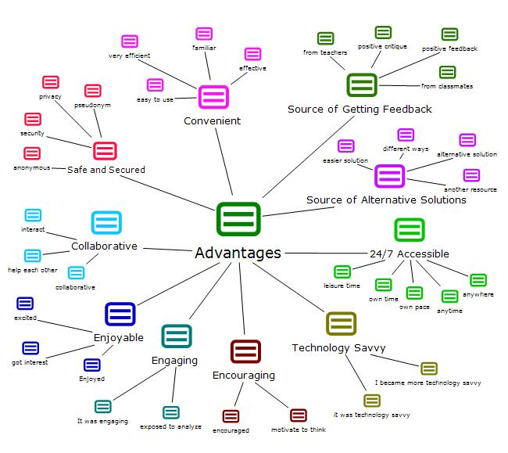
DATA ANALYSIS, RESULTS, AND DISCUSSION
Research Question 4: What do preservice secondary mathematics teachers perceive as the advantages and disadvantages of using a blog as a supportive tool in a Euclidean Geometry course?
Findings: Advantages of the Blogging Activity

Slide 27
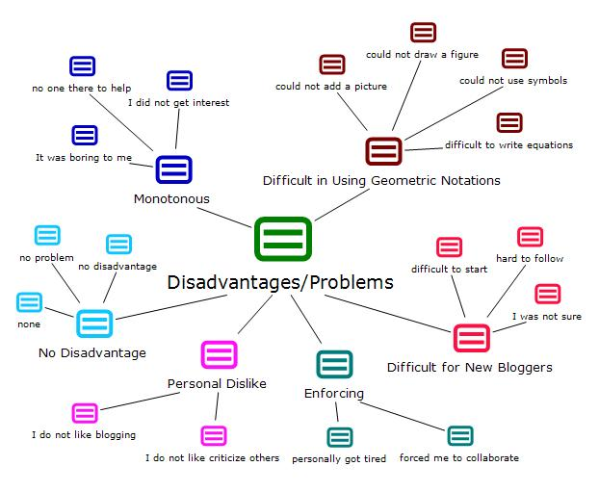
DATA ANALYSIS, RESULTS, AND DISCUSSION
Research Question 4: What do preservice secondary mathematics teachers perceive as the advantages and disadvantages of using a blog as a supportive tool in a Euclidean Geometry course?
Findings: Disadvantages/Problems of the Blogging Activity

Slide 28
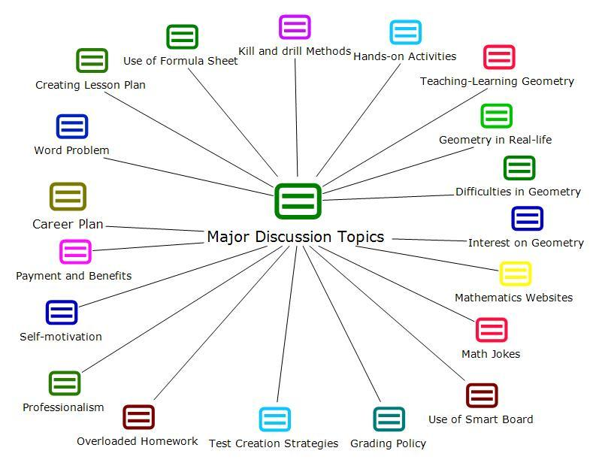
DATA ANALYSIS, RESULTS, AND DISCUSSION
Research Question 5: What trends emerge in the analysis of student contributions to an online discussion board on a blog used in a college Euclidean Geometry course?
Findings: Major Topics Raised on the Online Discussion

Slide 29
Preservice Mathematics Teachers’ Perceptions of Using a Web 2.0 Technology as a Supportive Teaching-Learning Tool in a College Euclidean Geometry Course
IMPLICATIONS, RECOMMENDATIONS, AND CONCLUSIONS
Implications for Practice
No unfair advantages to male or female participants
Preservice teachers found it positive and effective
New teaching-learning tool – could be included in the schools, and teacher education curricula
Participants need sufficient access to the Internet
A number of advantages; many of which match with the NCTM Principles and Standards
No major disadvantages/Only a few minor problems
Can develop collaborative teaching-learning environment
A free and public forum for online discussion

Slide 30
Preservice Mathematics Teachers’ Perceptions of Using a Web 2.0 Technology as a Supportive Teaching-Learning Tool in a College Euclidean Geometry Course
IMPLICATIONS, RECOMMENDATIONS, AND CONCLUSIONS
Limitations and Delimitations
The study dealt with a single class of 28 students
The study has only about 51% chance of finding a significant mean difference between the groups, if it really existed
Non-parametric tests were used
Euclidean Geometry problems that required participants using construction tools or uploading of images and graphs were avoided
Participants were asked to type mathematical formulas in plain text format
Did not use a control/experimental group
Did not measure the instructor’s perceptions

Slide 31
Preservice Mathematics Teachers’ Perceptions of Using a Web 2.0 Technology as a Supportive Teaching-Learning Tool in a College Euclidean Geometry Course
IMPLICATIONS, RECOMMENDATIONS, AND CONCLUSIONS
Recommendations for Further Research
Replication of this study in another college Euclidean Geometry Course
Replication of this study in a online college Euclidean Geometry Course
Replication of this study in a high school Euclidean Geometry Course
Conduct the quantitative and qualitative components in different ways
Improve the instruments used in the present study.

Slide 32
Preservice Mathematics Teachers’ Perceptions of Using a Web 2.0 Technology as a Supportive Teaching-Learning Tool in a College Euclidean Geometry Course
IMPLICATIONS, RECOMMENDATIONS, AND CONCLUSIONS
Conclusions
Use of a blog in a College Euclidean Geometry Course is enjoyable and effective
No significant difference in the measures of attitude and perceived effectiveness on Gender and Course assessment
However, participants who spent more time on the Internet perceived better effectiveness
Numerous advantages. No mentionable disadvantages - only a few minor difficulties
Collaborative, motivational; anytime, anywhere, easy accessible
Participants found blog as an open and public forum
Numerous potential to improve teaching-learning mathematics

Slide 33
Preservice Mathematics Teachers’ Perceptions of Using a Web 2.0 Technology as a Supportive Teaching-Learning Tool in a College Euclidean Geometry Course
REFERENCES & APPENDICES
References and Appendices are
included on the print copy

Slide 34

Preservice Mathematics Teachers’ Perceptions of Using a Web 2.0 Technology as a Supportive Teaching-Learning Tool in a College Euclidean Geometry Course
QUESTIONS & ANSWERS
Thank You

